Slide 1
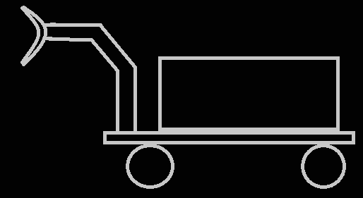
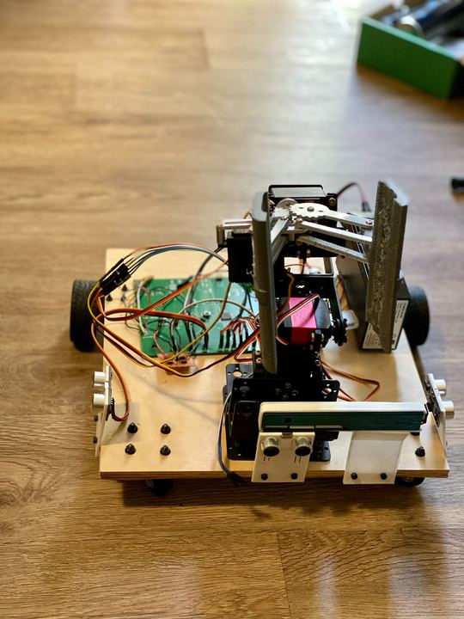
Rolling Arm
Senior Design Project
CECS 490B
CSULB Fall 2019
Bryan Linares, Thomas Nguyen, Kevin & Cristian Lopez

Slide 2
Overview
Project Goal
Product Specification and Constraints
Functional Components Used
Mechanical Solutions
Problems Identified and Addressed
Hardware Selection & Development
SBC Software Solutions & Summary
User Interfaces
Power Requirements and Solutions
Demo
Notes:
thomas

Slide 3

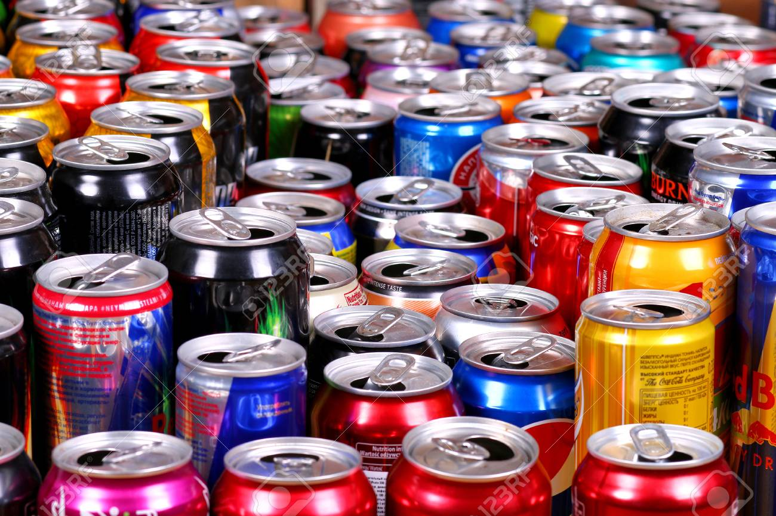
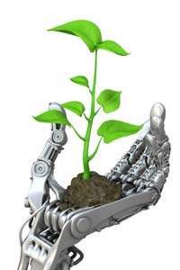
Project Goals Reached
An autonomous can picking robot car using a camera and an arm with a claw to pick up cans and put them in a bin.
Autonomous Mobile Robot
6 DOF axis arm programmed to pick up cans
Ability to detect cans using computer vision
Balanced and stable while picking up cans.
2 hour battery life.
Safe to operate
Cleaner environment in mind.
Notes:
Bryan

Slide 4
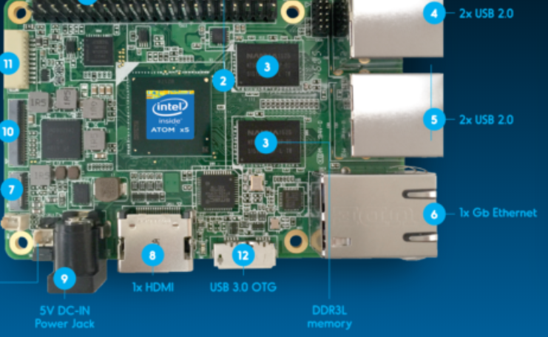
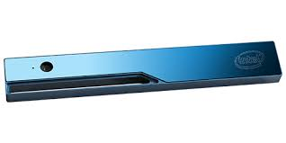
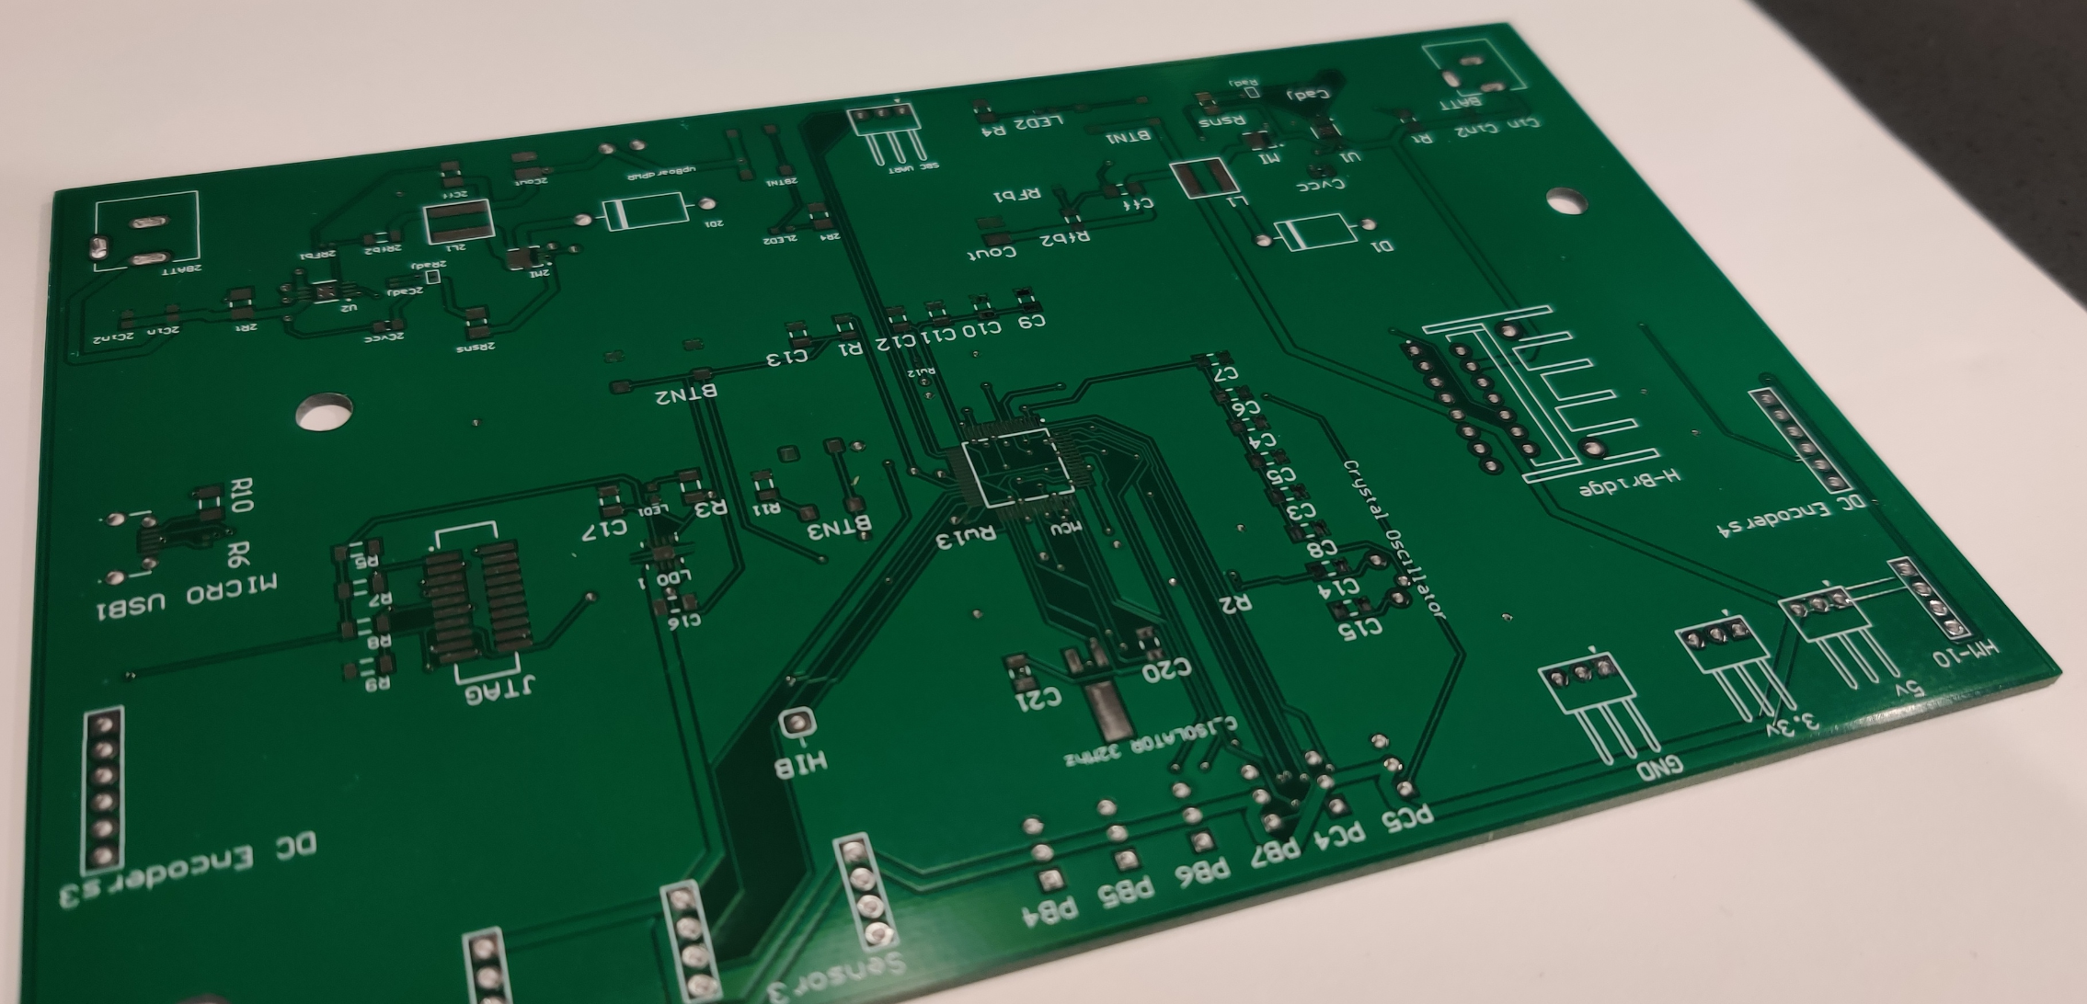
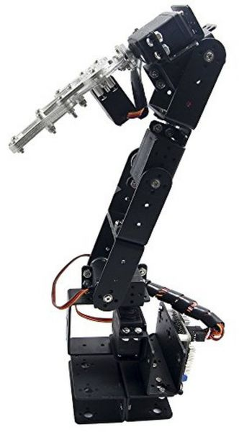
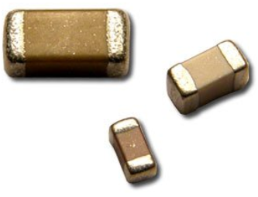
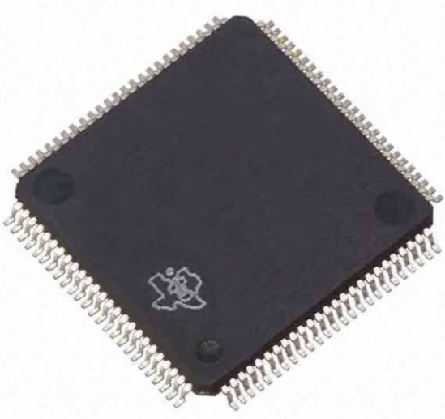
Product Specifications and Constraints
Single board computer that is capable of running a camera
Microcontroller with 8 PWM pins and 1 UART input and output.
Dimensions x-y 40-40 cms and height about 60 cm height
Minimum of four axes of rotation for the arm. Is able to reach up to 15 centimeters.
Strong servo motor to withstand weight of the arm.
Able to grasp Plastic/Aluminum bottles
Wood for car body to withstand 55g weight of the arm and 20g for the load.
DC Motors for wheels, Speed controlled by PWM
Front facing Camera to view objects, specifications give an outside range of 10 meters, inside up to 3.5m.
PCB for efficiency and reproducibility
Notes:
Bryan

Slide 5
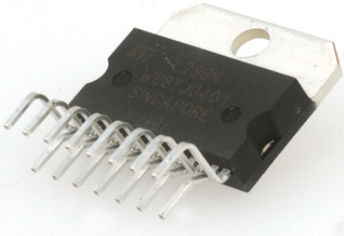
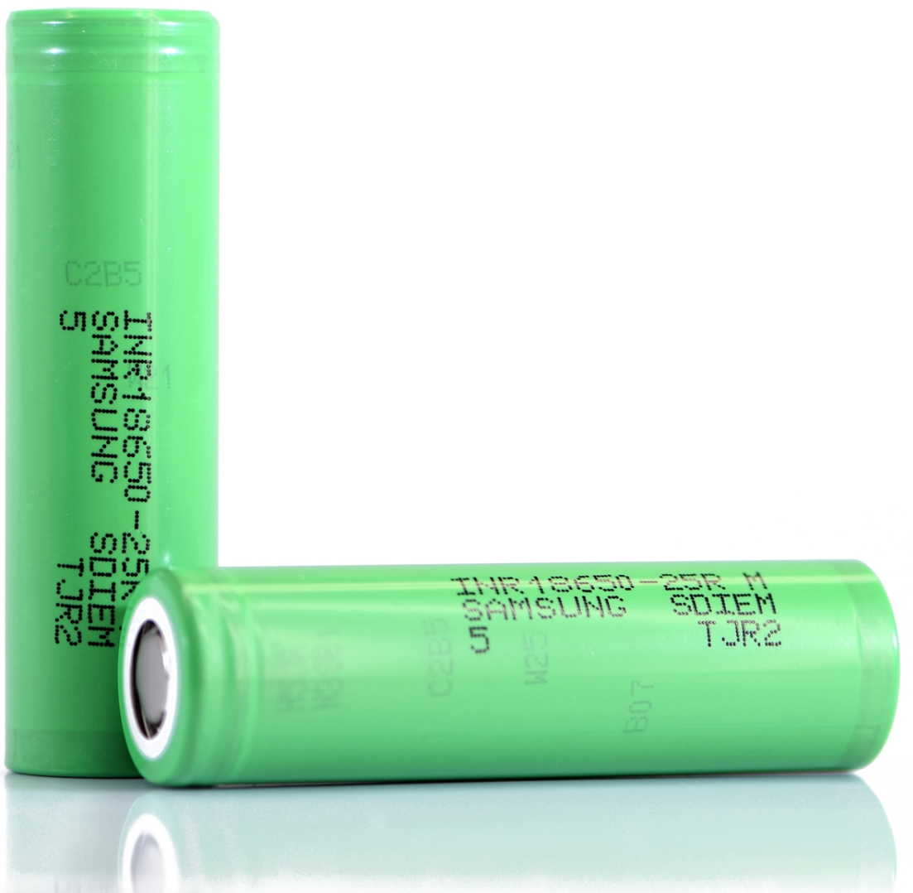
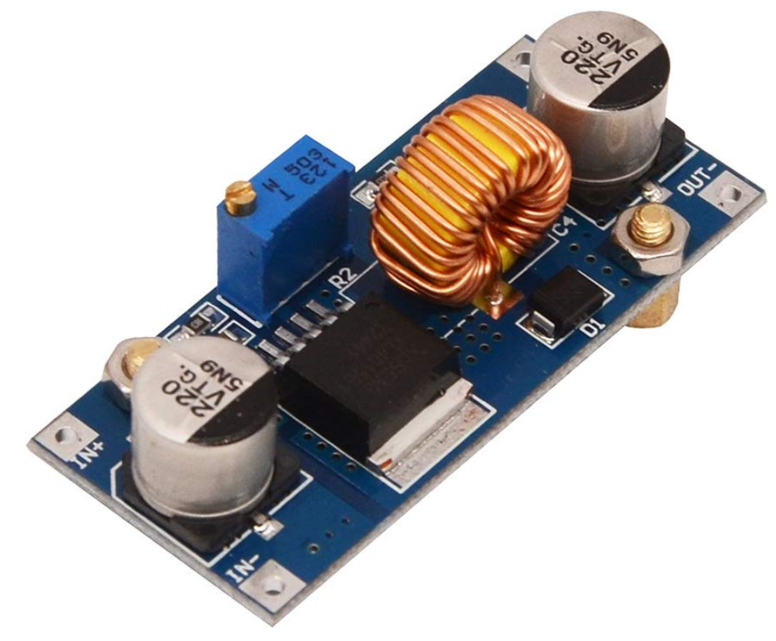
Functional Components Used
Intel Realsense R200(480p30)
Ultrasonic Sensors
Intel UP Board
6 axis robotic arm
6 high torque servos
2 DC encoder motors
TM4C123 Microcontroller
L298 H-bridge chip
2 buck converter modules at 5V
Lithium Ion 2500mAh 20A Battery
Notes:
Cristian

Slide 6
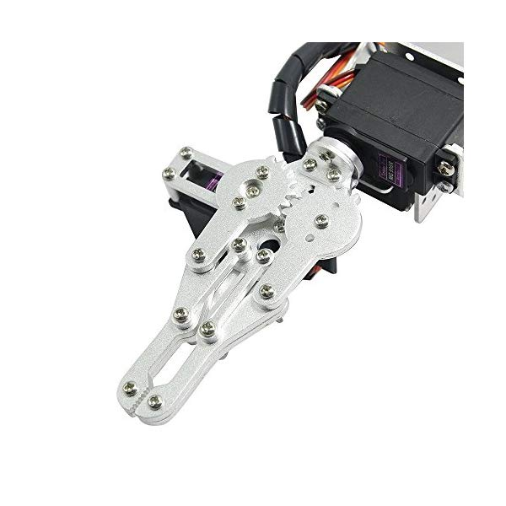
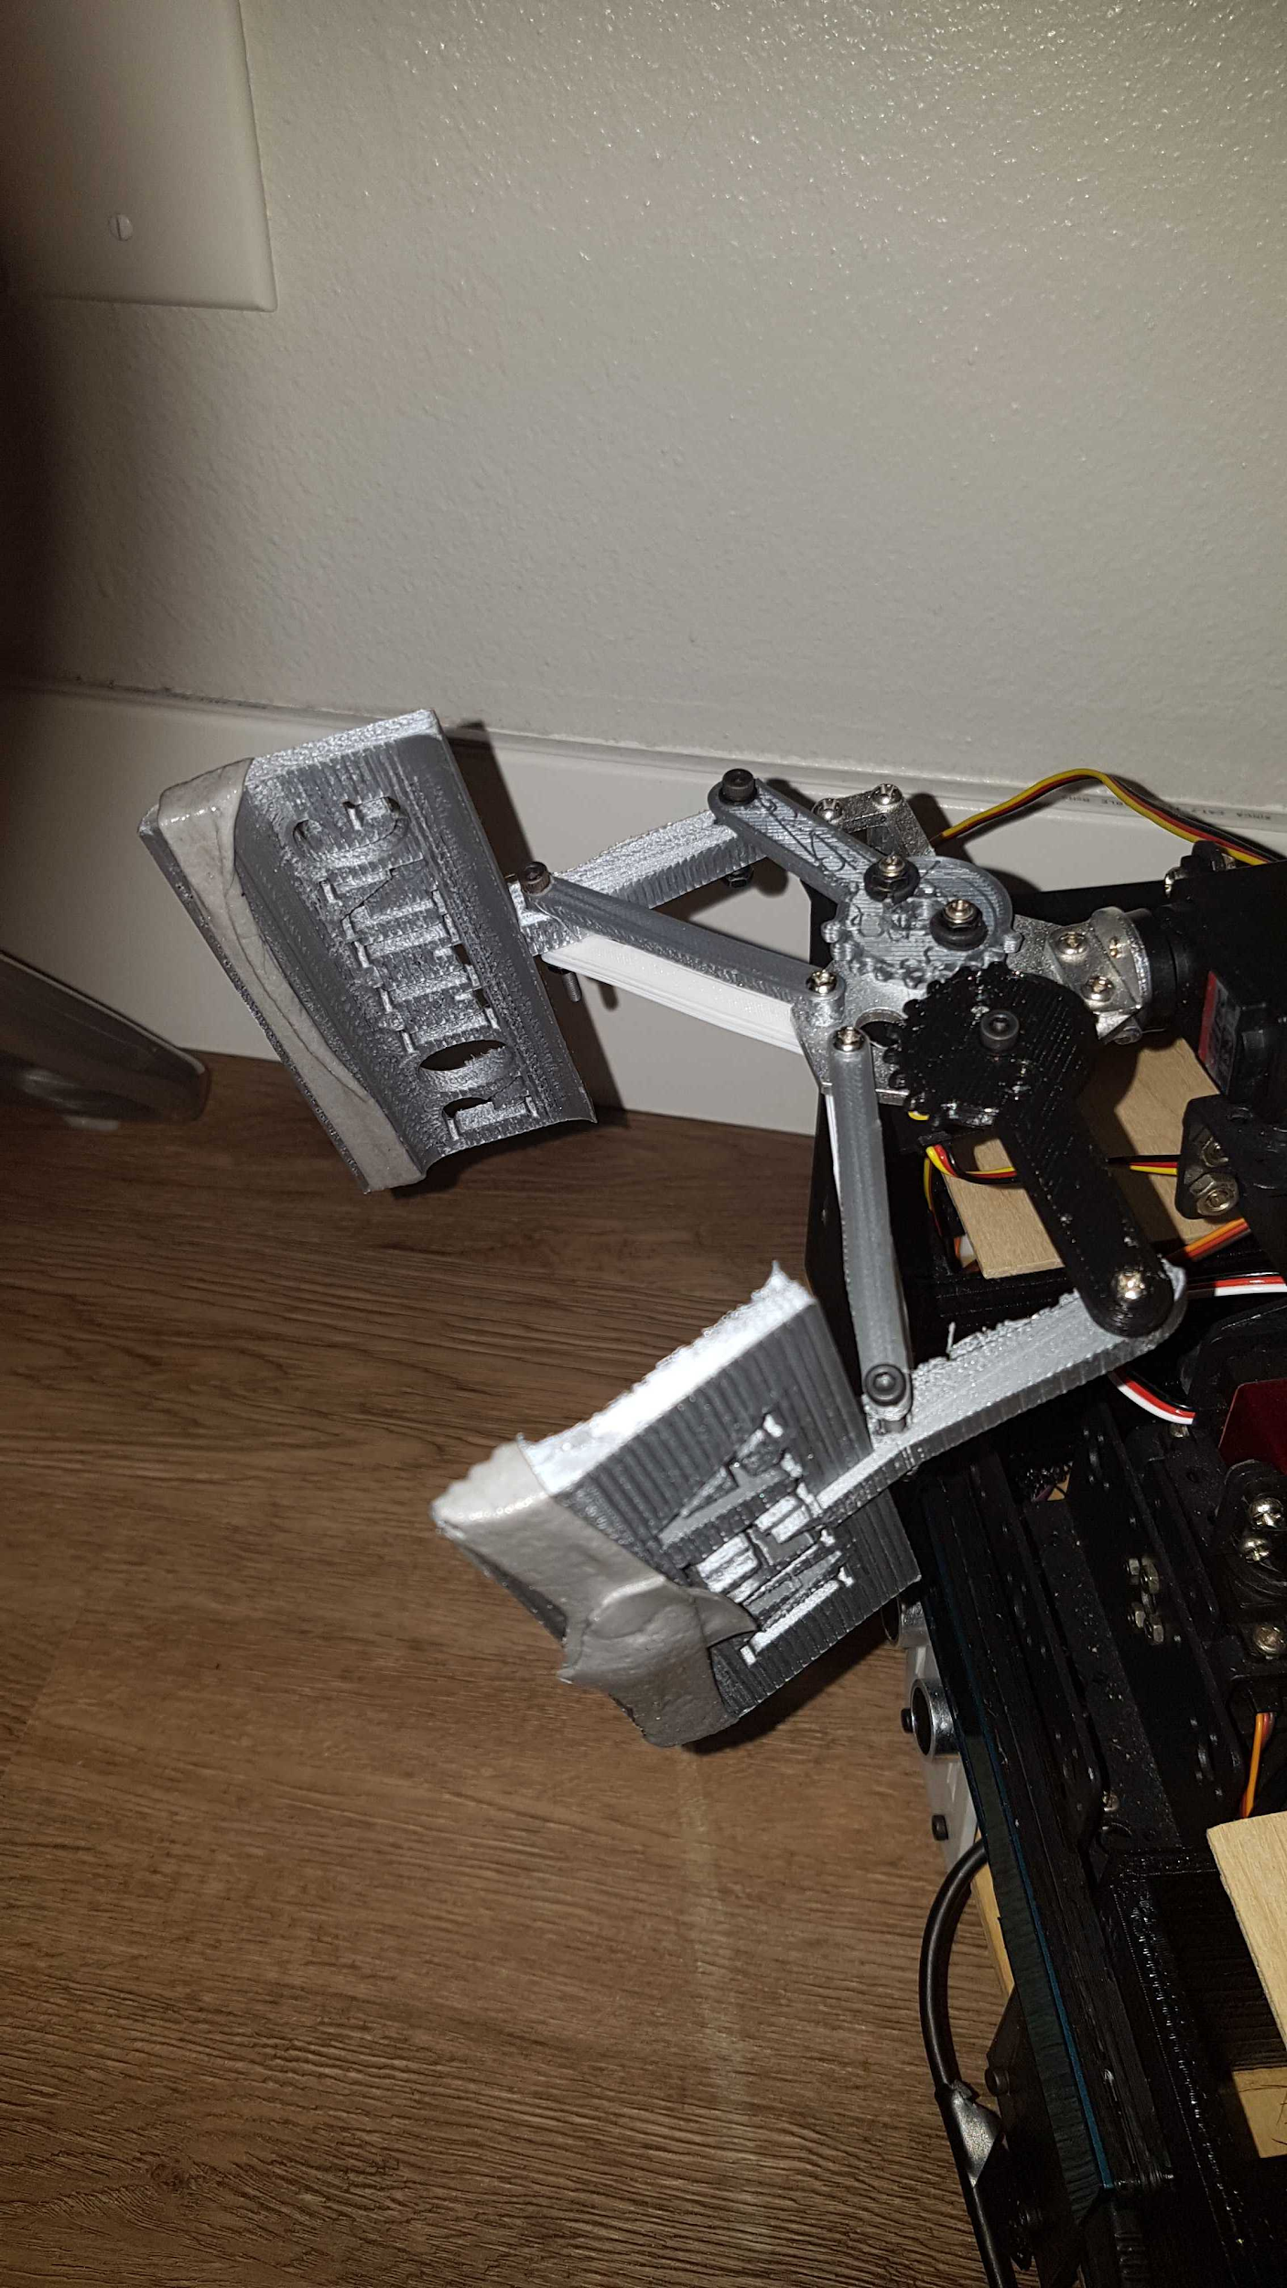
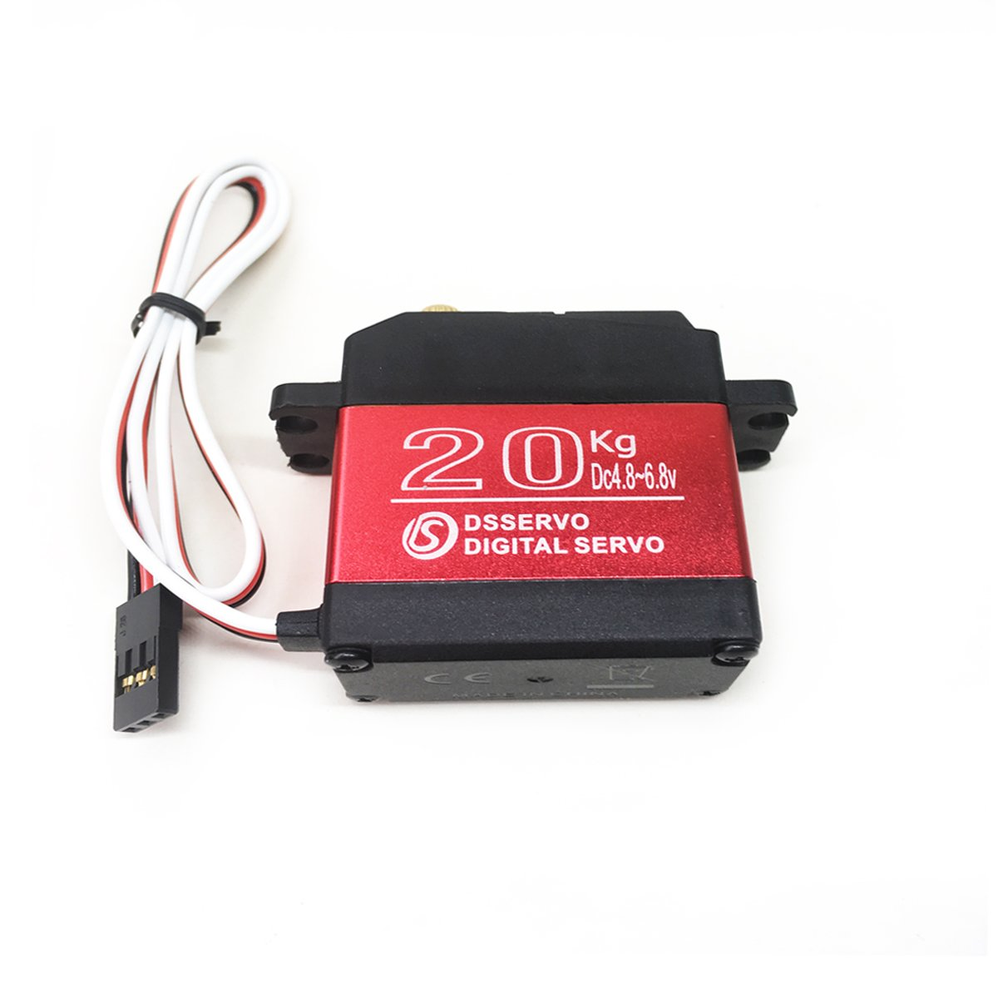
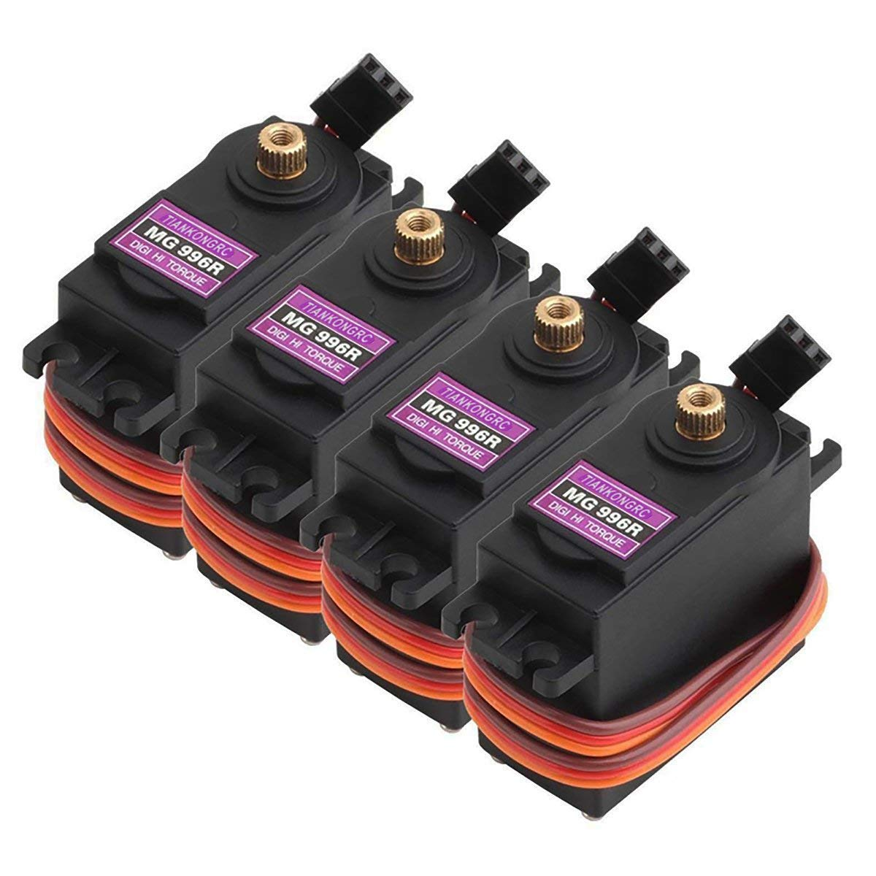
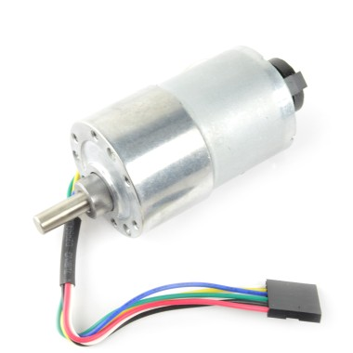
Specific Mechanical Solutions
Aideepen ROT3U 6 axis Arm
Calibrated each individual servo(MG996R 55g).
Servos with Higher torque (ANNIMOS 20KG)
Custom 3D Printed Claw For easier Grabbing
2 Motorized Wheel on base platform
2 55 RPM DC Motor 2 Caster Wheel
Wood Base Car
Custom 3D printed Sides.
Notes:
Bryan

Slide 7
Problems Identified and Addressed
Servo Torque limited to 10 kg/cm at 5V.
MCU Software with UltraSonic Sensors. SBC Software compatiblity
Built in buck Power supply, did not work, had to solder one onto the board
JTAG interface circuit
Soldering issues, the pins bridging and board not behaving like we expect
Collisions at corners, added switches
Detecting cans by computer vision
High speed motors would not operate constantly at required speeds, were too fast and weren’t reliable to reach cans
Major Improvement needed: Improve image recognition speed
Notes:
Kevin
Some of the problems we encountered were
Servo weight which was encountered last semester
The built in power supply that we build
The J-Tag interface was a problem and finicky
SInce we build a pcb we got some soldering problems in general,
One of the problems was the pins on hte lunchpad werent making conctact with the pcb and we endded up buring the pads on hte pcb. This happened twice, for the second time we didn't want to switch to the old one so we just lifted up hte pin form the lunch pad and soldered directly to a via.
We also had a problem with the computer vision in where we couldn’t install libraries using RealSense and OpenCV in c++
The

Slide 8
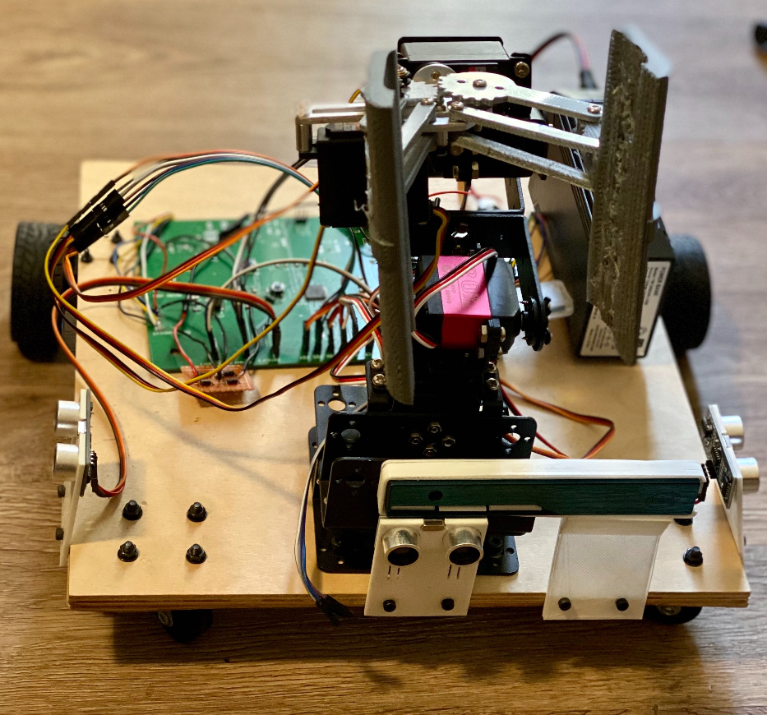
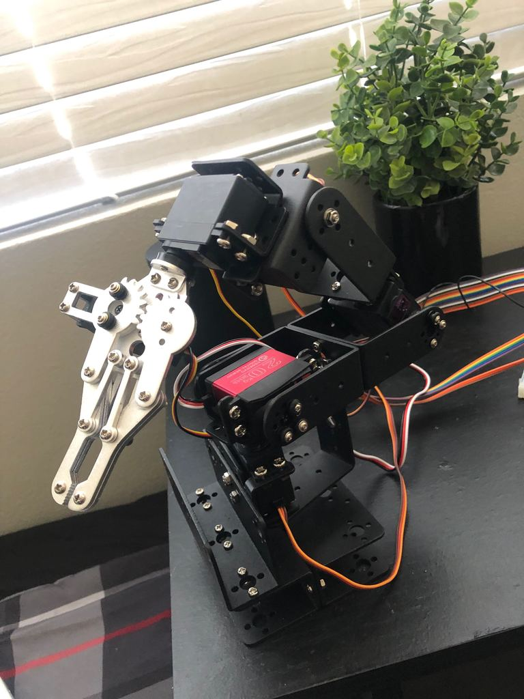
Hardware: Selection and Development
Intel UP-Board SBC over other SBC like Raspberry Pi
For full compatibility with intel camera
Necessary power to process camera data; Atom x5-z8350 Processor 1.92 GHz CPU, 4GB RAM
Onboard memory so less worry about corrupt SD card; 32GB+
Shares similar external pin count and layout as Raspberry Pi
Professional and Industrial use
Aideepen ROT3U arm used
Six possible axis
TM4C123G, hardware features used
48 pins( Motor direction, UltraSonics)
2 UARTS
8 PWM pins
Notes:
Thomas

Slide 9
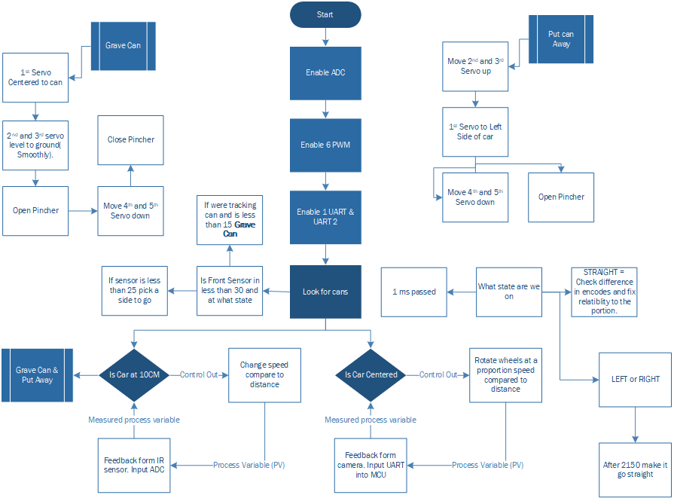
Arm Software Solution
6 PWMs are used to controlled the arm
6 Functions are created to ease the control of arm
2 Functions are created to grab a can and put away a can
Once we get a UART signal Arm attempts to grab can and puts it away
Sensors are Used to check when we are in front of the can or when we have approached a wall and send interrupt
Notes:
Kevin
Basically our car is running autonomously aboividing to crash and to travel to places that it has previously visited
If we get a UART data with a can position we will get into a tracking position
Then after we we’re between 15 cm from the can we will perform the graving of the can
And we have PID loops for the Straight moving and the centering of the can
Basically how the software works is hte car is moving and if it encounters any object with in 25 cm the car will turn to hte open side.
If we get a UART data for the can will will enter another state in where were tracking the can and will drive inFront of it using a Portion PID loop
And when we get infront of the can will grave it and we will do this again.

Slide 10


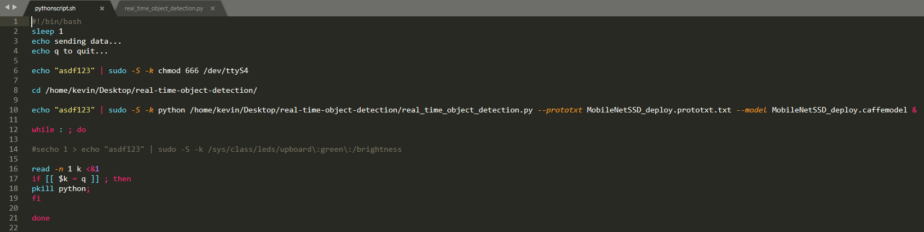
UP Board SBC Software Solutions:
Intel RealSense, OpenCV, Python 2.7, and Bash Script on Linux 16.04
Script sets up UART permissions, and begins program on startup
General detection method is using pretrained caffemodel file, checks for confidence of object
OpenCV code draws a box around the object and transmits the center location
Notes:
Bryan

Slide 11
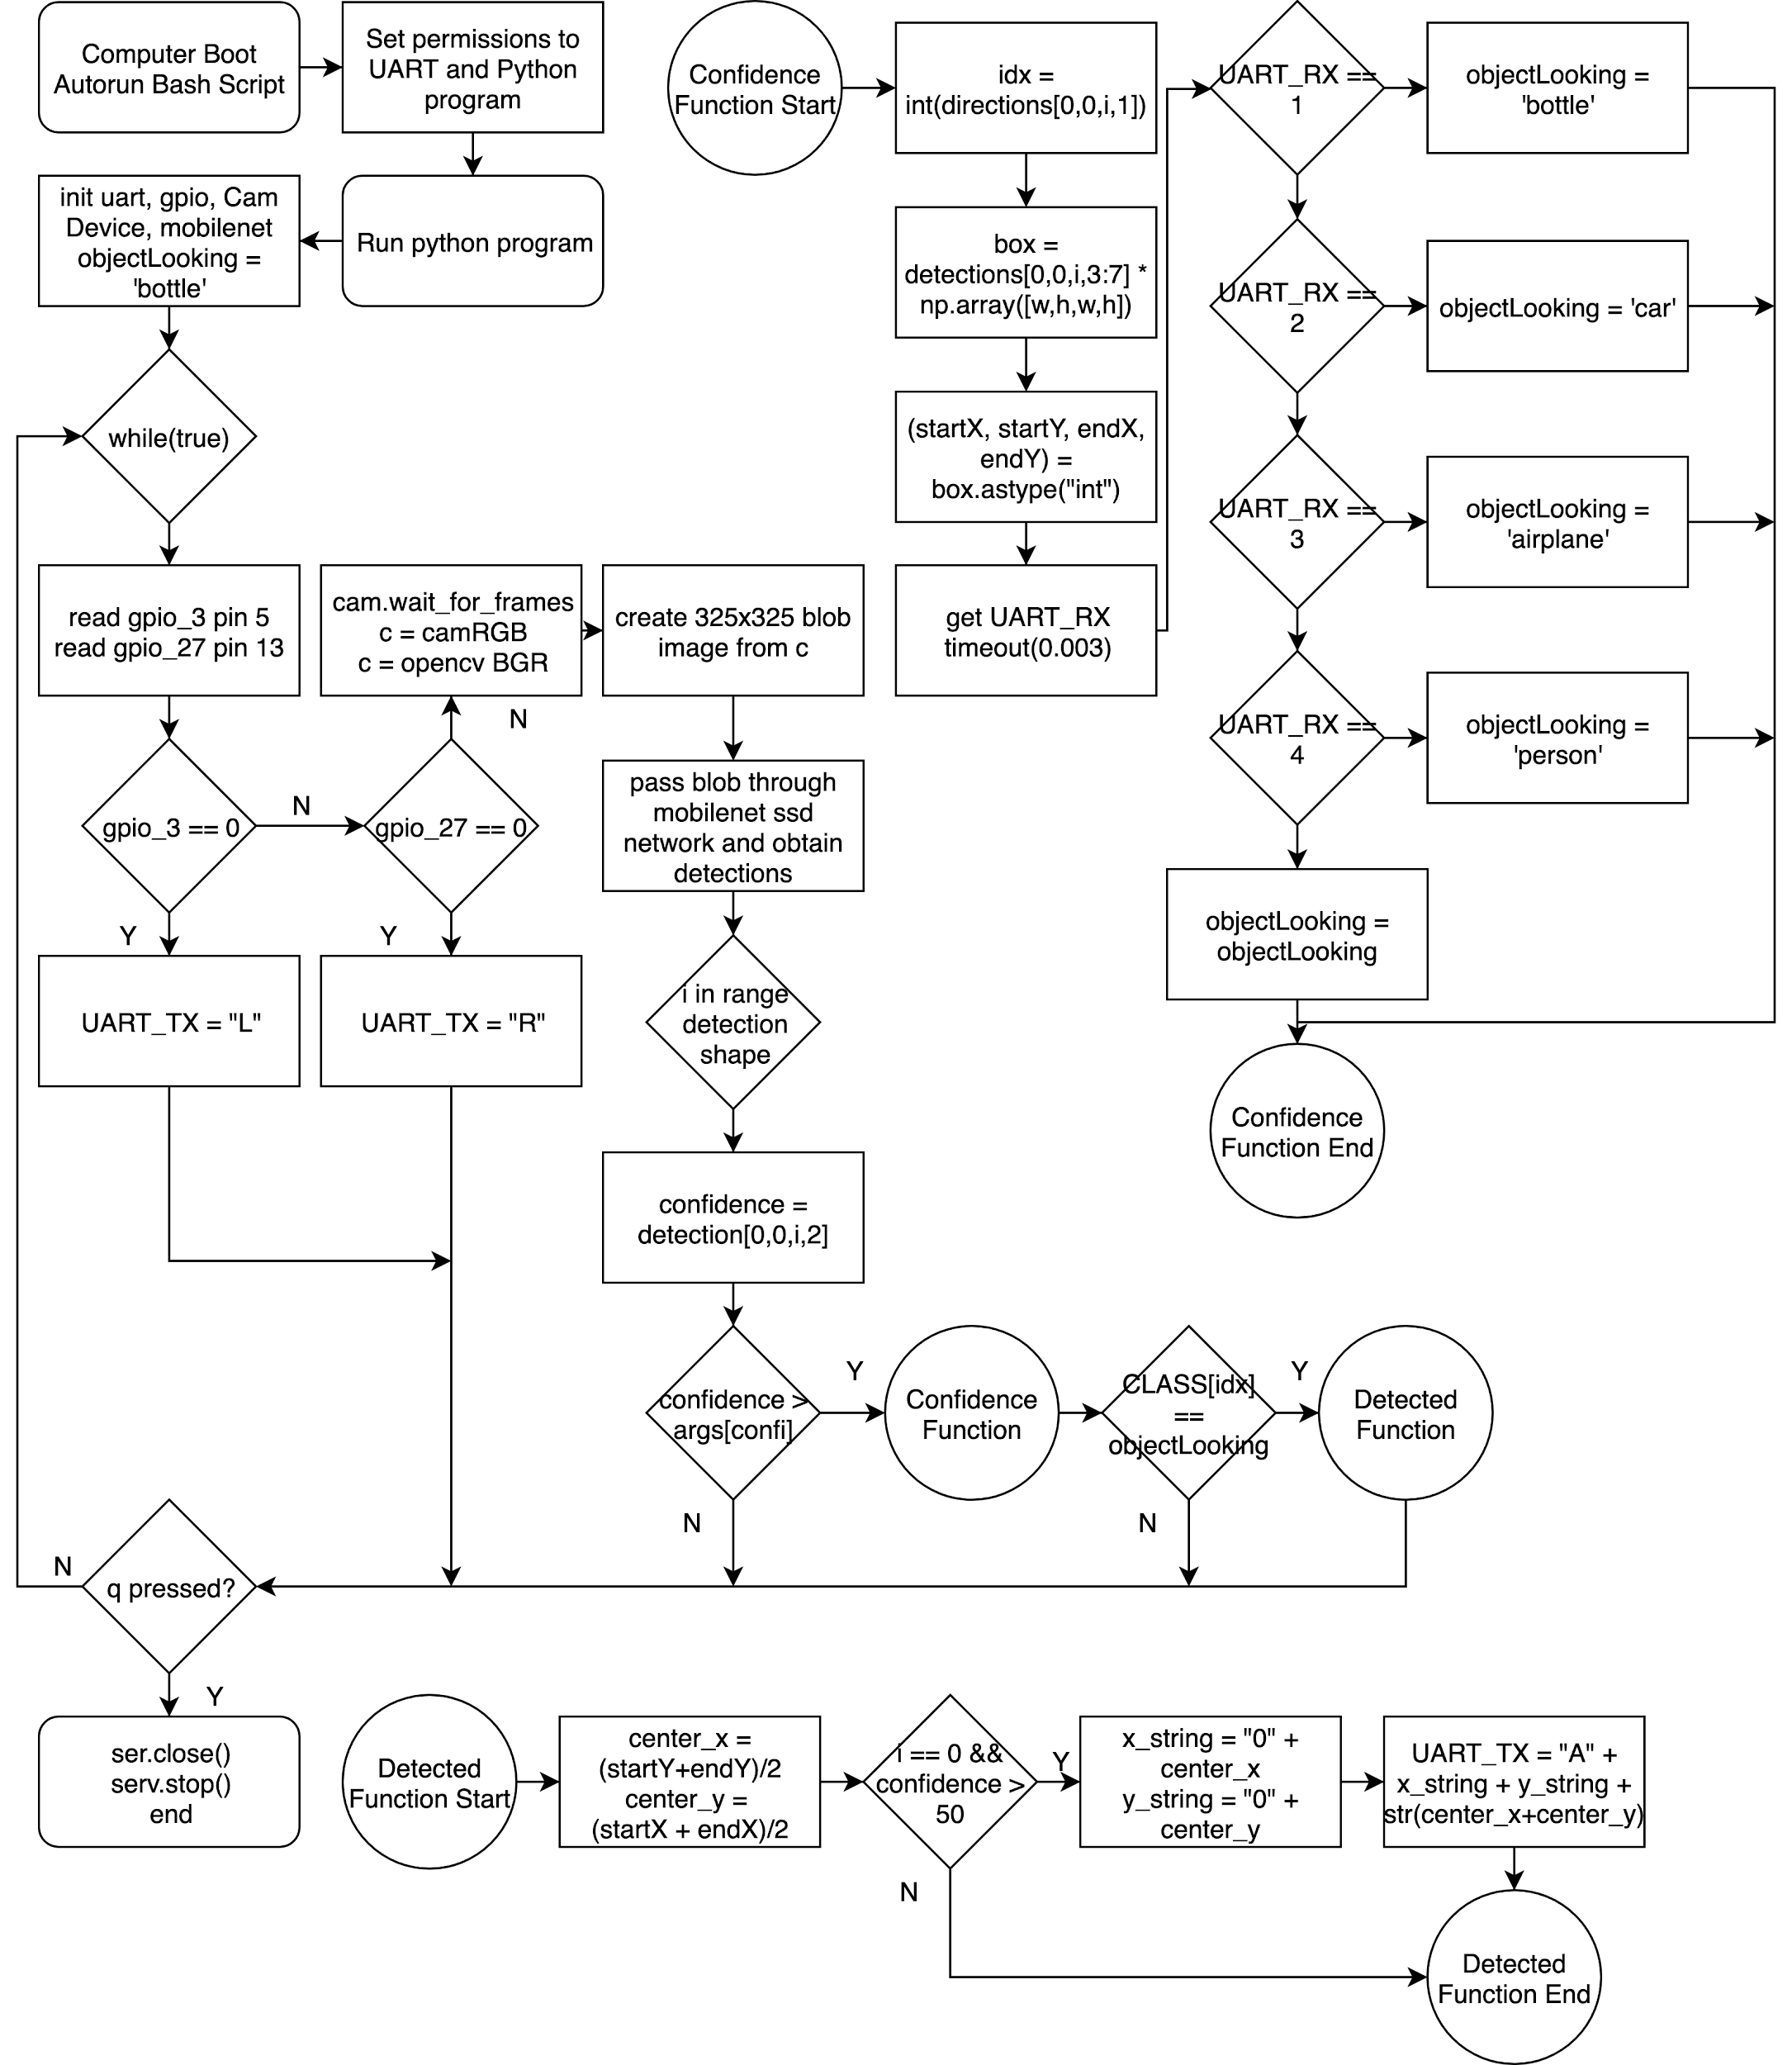
SBC Software Solutions Summary:
Initializes 8O1, 115200 baud UART for pin 8 & 9. UART Timeout = 0.003 sec. GPIO pins as input for 5 & 13. Set object classes. Define device port for Realsense Camera at 640x480
Main loop: Check active low GPIOs else run camera code. If active, transmit UART “L” or “R”
Convert RealSense frames to OpenCV matrix and create blob image at 325x325. Use blob image to detect object class (shapes).
Checks received UART for selected object ID from bluetooth. Default: Bottles/Cans. Others: Cars, Planes, People.
Draws box around shapes and checks confidence then transmit center x, y coord through UART. If no detection, coord is all 0.
11 bytes. “A” + “x coord” + “y coord” + “x+y total”
Notes:
Thomas

Slide 12
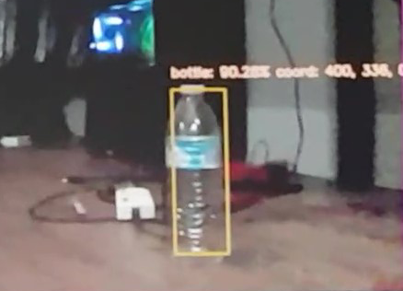
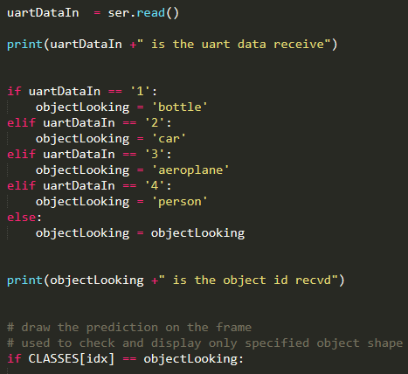
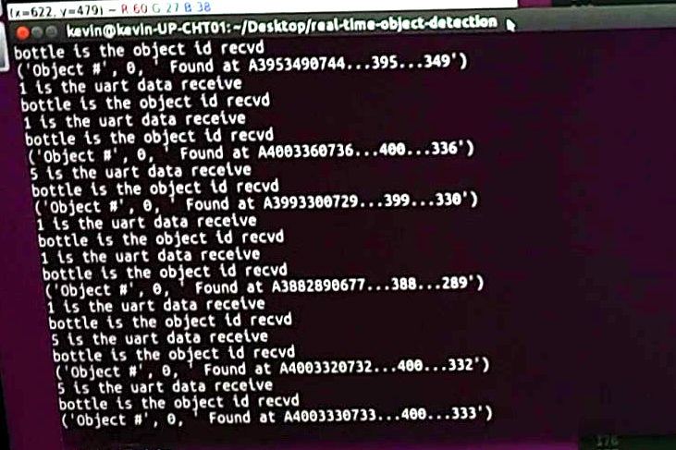
SBC Software Solutions Continued
Visible box and labels and text dumps are for debugging purpose. (can be hidden, including video stream to increase speed)
Multiple same shapes can be detected but we only look at the first shape in the array.
Object to be detected can be changed through bluetooth (default initialized to bottle)
Notes:
thomas

Slide 13
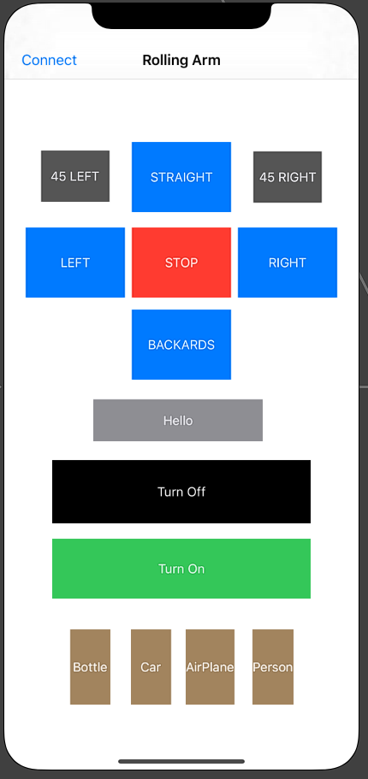
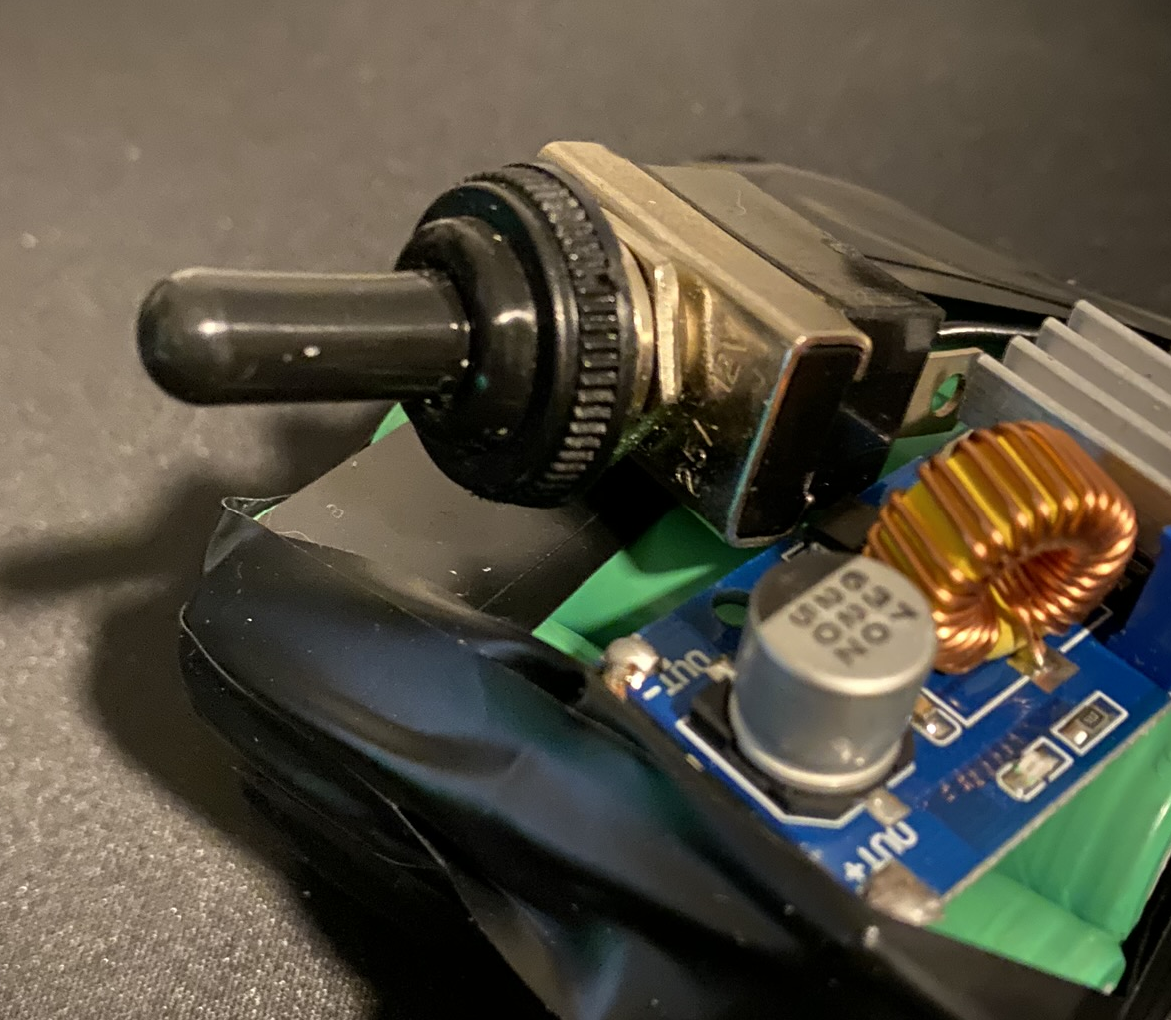
User Interfaces
User interactions are minimal since the project aims to work autonomously other then turn on button and bluetooth for different object recognition.
Notes:
Kevin
Our interfaces are pretty simple since want it to wokr right away. We have 2 switches one for the upbard and one for hte TM4C. We actually dont need a any devices to access hte SBC since we have a sctrip that makes our code run automatically.

Slide 14
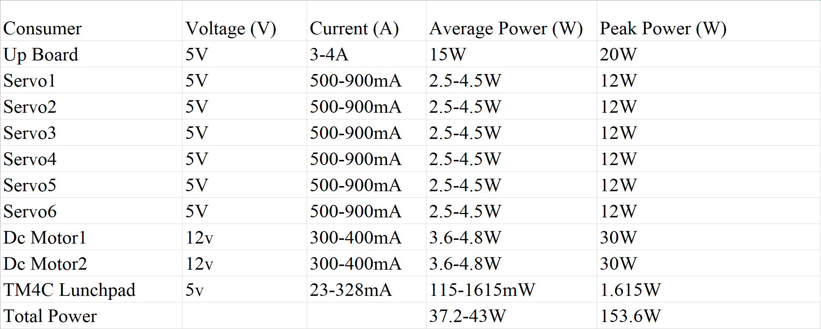
Power Requirements and Solution
High power system
Intel Up board requires a lot of power.
Supply constant power to Up board and TM4C Launchpad.
Notes:
cristian

Slide 15
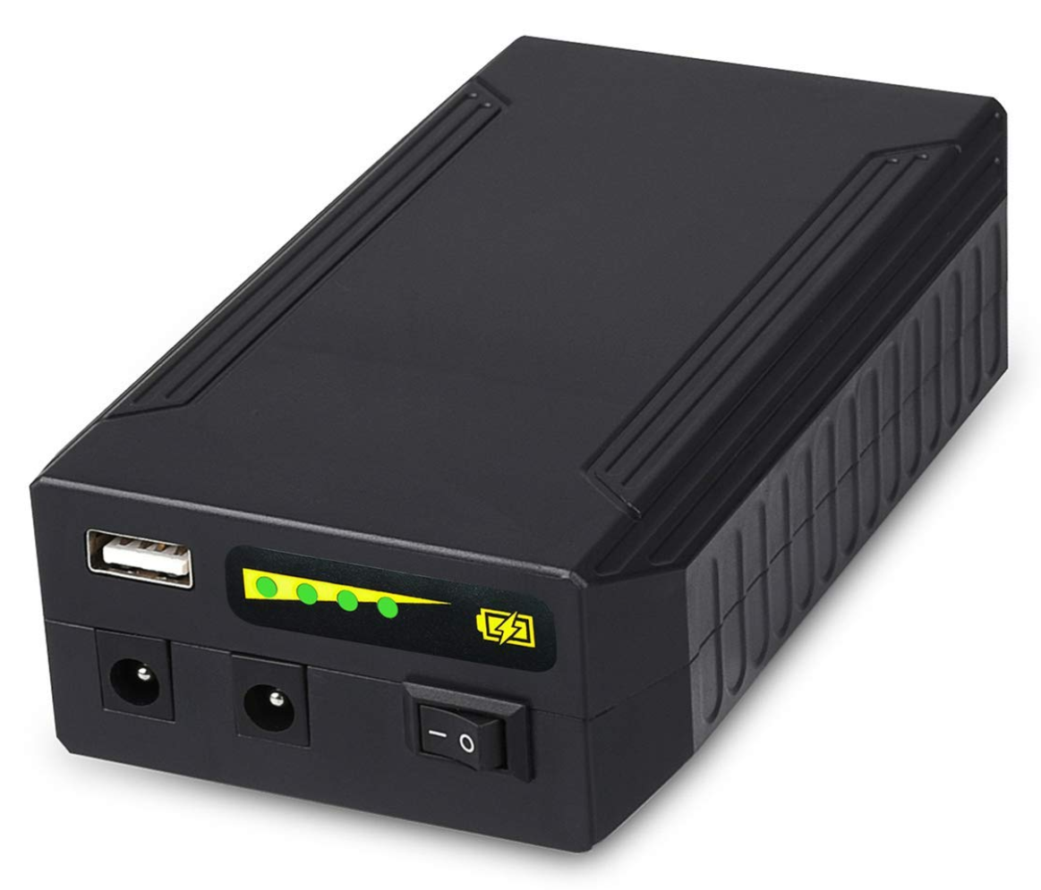
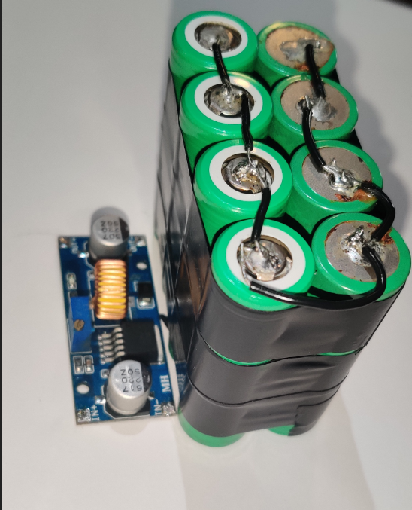
Power Requirements and Solution
Rechargeable Battery 12v - 6A powers all motors
Regulates Voltage from 9 to 12v and it can deliver up to 6 Amps.
Lithium ion Samsung 25R-18650 delivers 25 Amps at 3.6V.
8-battery set can deliver up to 100 Amps at 7.2V
Output is regulated using a buck converter module to 5V.
Notes:
cristian

Slide 16
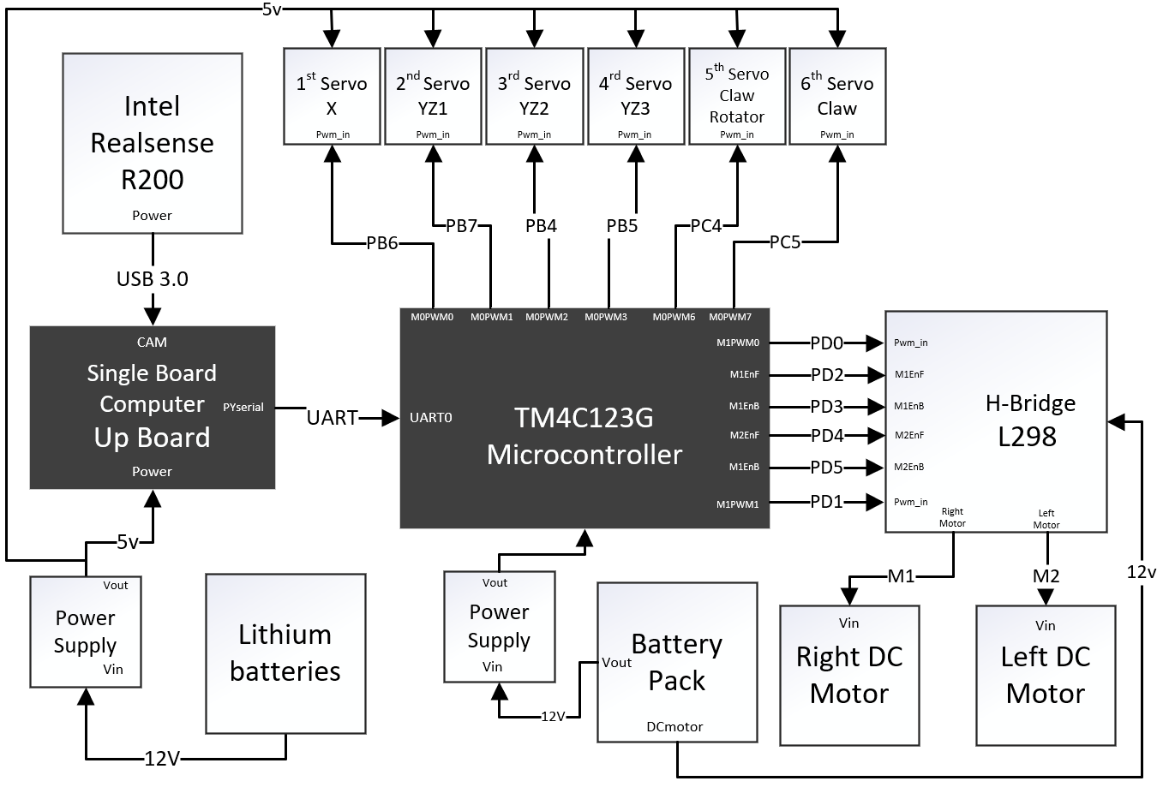
Hardware Block Diagram
Notes:
Cristian

Slide 17
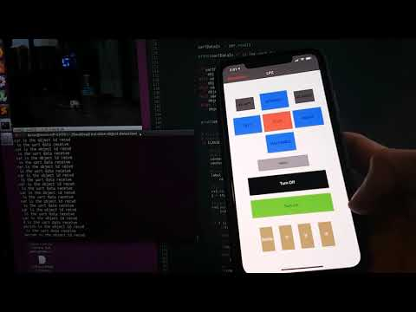
Image detection & Bluetooth app
Notes:
Thomas

Slide 18
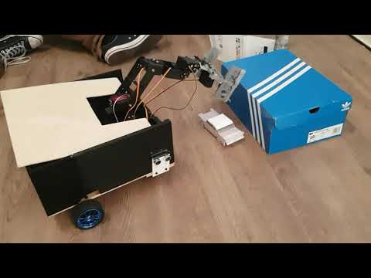
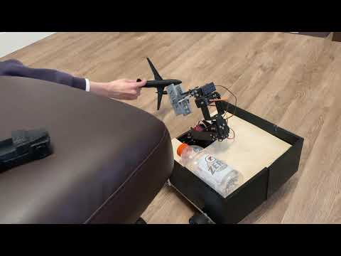
Airplane and Car Detection

Slide 19
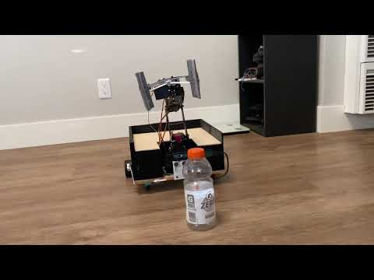
Intro Video
Notes:
Thomas

Slide 20
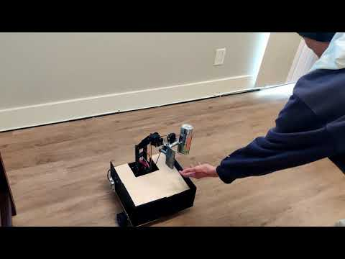
Rolling Arm

Slide 21
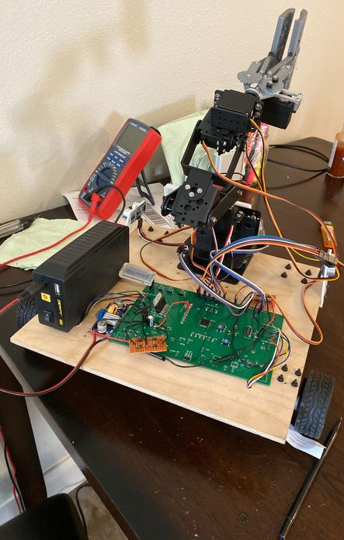
Rolling Arm

